Slide 1
The activation and control of racial attitudes
Hannah Volpert
SPAM presentation
5.8.15

Slide 2
Theoretical background
Method
Data collected in the fall
Data collected in the spring
New directions
Feedback appreciated!
Notes:
Theoretical background on implicit measures of racial attitudes

Slide 3
Theoretical background
Method
Data collected in the fall
Data collected in the spring
New directions
Feedback appreciated!
Notes:
Theoretical background on implicit measures of racial attitudes

Slide 4
Attitudes about other social groups have long been of interest to social psychologists
Processes that are involved: social categorization, activation of attitudes, and how (and what kinds of) behavior is produced according to those attitudes

Slide 5
Need for implicit measures when it comes to measuring socially sensitive attitudes
Several have evolved in the last couple decades
IAT
Sequential priming tasks
Affective priming
WIT/shooter task
The important thing about implicit tasks is that they’re thought to tap into spontaneous processes that unintentional and uncontrollable (we’ll come back to that later)

Slide 6
Sequential priming paradigm
Process I
Process II
Presentation
Attitudes
Behavior
(congruency effect)
Notes:
Sequential priming refers to paradigms where a prime is presented, followed by a target, and the extent to which they are congruent on some dimension, whether it’s valence or some semantic link, facilitates the response to the target.
Moors, Spruyt and De Houwer attribute the priming effect into two process, which they call Process I and Process II
Priming effects assume that this is generally what’s happening: that the presentation of a stimulus automatically activates a representation of that concept in memory, which then leads observable behaviors (such as faster reaction times)
In social psychology, this paradigm is incredibly useful because it gives us a way to measure attitude activation by measuring observable behavior, so we can look at conditions under which certain attitudes are activated, or what kinds are activated in response to various stimuli.

Slide 7
Sequential priming paradigm
Process II
Presentation
Attitudes
Behavior
(congruency effect)
Spreading activation
Processes in response-selection stage
Notes:
Lots of research has been done that focuses on Process II and how the activation of an attitude facilitates a “congruent” response
Spreading activation
Activation of mental representation of prime spreads to related concepts, which facilitates responses since those concepts are already activated
Response selection (especially in experimental paradigms with limited number of responses)
Response mapping/conflict
Illustrated by contrast effect research

Slide 8
Sequential priming paradigm
Process I
Presentation
Attitudes
Behavior
How does perceptual information about a stimulus activate an attitude?
What are these processes dependent on?
How is this relevant to the perception of other people?
Notes:
`Jon Freeman and Nalini Ambady have proposed a dynamic interactive model of person construal that suggests lower order perceptual features interact with high order cognitions in activating attitudes, especially social categories

Slide 9
Previous face processing literature shows evidence that face processing (as measured by the ORB) changes as a function of fixation
Suggests possibility that where people fixate on the face may affect the processes that lead to attitude activation

Slide 10
Theoretical background
Method
Data collected in the fall
Data collected in the spring
New directions
Feedback appreciated!
Notes:
Theoretical background on implicit measures of racial attitudes

Slide 11
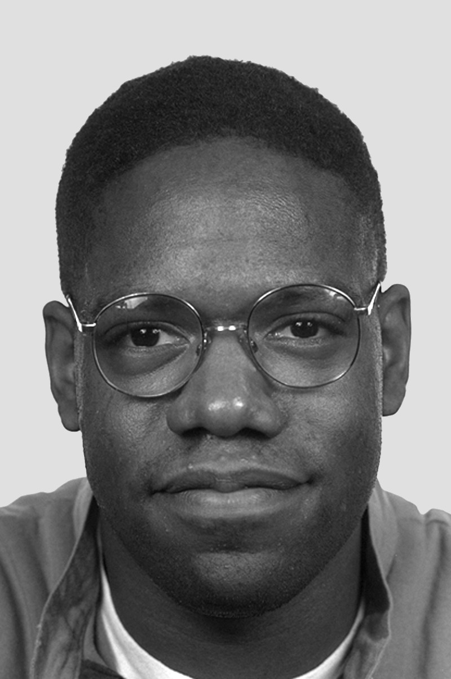
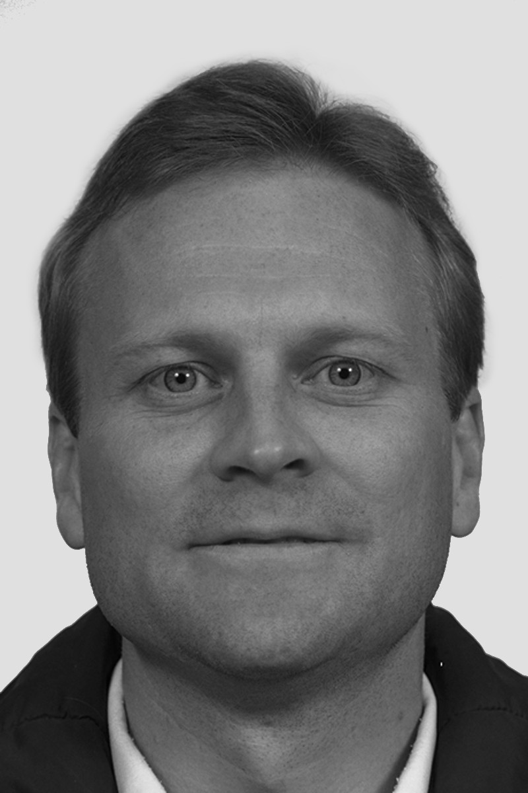
Fazio, Jackson, Dunton & Williams (1995)
likeable
*******
disgusting
Notes:
Photos were color
Prime presented for 315 ms
135 ms before target (450 SOA)
Embedded within an elaborate 5 block task, in order to disguise the racial nature of the task
In the interest of time, I cut it down to 3 blocks: practice block, priming block, and recognition block

Slide 12
+
cockroach
+
vacation
+

Slide 13
Example of forehead fixation trial
+
cockroach

Slide 14
Example of nose fixation trial
vacation
+

Slide 15
Hypotheses
Changes in attentional focus due to fixation will change the extent to which racial attitudes are activated
Differences in attitude activation will affect the congruency effect of facilitating responses to positive and negative words
Presentation
Attitudes
Attitudes
Behavior
Notes:
REMEMBER TO MENTION RECOGNITION BLOCK
Each of the 24 faces from block 2 was presented, along with 24 new faces
Just had to indicate whether they recognized the face or not

Slide 16
Fixating on features that have race-relevant information and help categorize faces by race will lead to a stronger activation of attitudes related to race
ie nose fixation will lead to larger congruency effect than forehead fixation

Slide 17
Theoretical background
Method
Data collected in the fall
Data collected in the spring
New directions
Feedback appreciated!
Notes:
Theoretical background on implicit measures of racial attitudes

Slide 18
Recognition block
Notes:
27 subjects
2 excluded
Demographics: gender, race

Slide 19
Priming block
- Analysis done on log transformed data, just correct trials
Fix
F(2, 48) = 3.354, p = .043 *
FaceRace
F(1, 24) = 10.47, p = .004 **
No interactions within fix condition significant
Notes:
27 subjects
2 excluded
Don’t have demographics

Slide 20
Priming block
- Analysis done on log transformed data, just correct trials
Fix
F(2, 48) = 3.297, p = .046 *
No contrasts within fix condition significant
Notes:
27 subjects
2 excluded
Don’t have demographics

Slide 21
Theoretical background
Method
Data collected in the fall
Data collected in the spring
New directions
Feedback appreciated!
Notes:
Theoretical background on implicit measures of racial attitudes

Slide 22
Methodological changes
Added ET (fixation stayed on screen until ET registered that they were looking in that spot)
Increased trials in priming block, each face was presented with each fixation
Took away recognition block

Slide 23
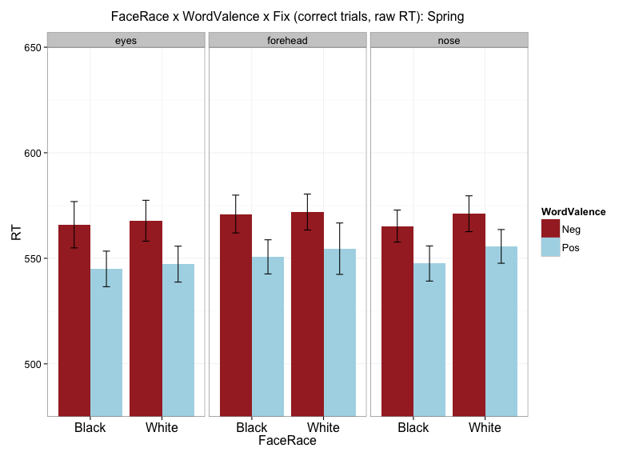
Priming block
Use Fig 5
Need to
Make .wmf to present conditions separately
Log transformed data
Main effect of WordValence
F(1, 52) = 33.22, p < .001 ***
Main effect of FaceRace
F(1, 52) = 4.951, p = .030 *
No interactions significant

Slide 24
Theoretical background
Method
Data collected in the fall
Data collected in the spring
New directions
Feedback appreciated!
Notes:
Theoretical background on implicit measures of racial attitudes

Slide 25
ORANGE BARREL REROUTE
Why did this happen and what could it mean?
Delved into the literature about the implicit nature and controllability of these tasks
In WIT task, both goals to control and public setting increases the reliance on stereotypic information- show larger priming effects (as measured by errors in stereotype-incongruent trials i.e. Black-tool trials)
Social facilitation effects
“White bear” suppression effect
Anxiety (stereotype threat) increases expression of automatic attitudes by reducing control
Leads to reliance on “dominant response”
In AP literature, handful of studies show that effect CAN be voluntarily controlled
Even with short response deadline
Evidence that attitudes themselves didn’t change, just control (Teige, Klauer, 2013)

Slide 26
Differences between results may be because
Different tasks
One relies on stereotypic (semantic) content
Uses errors as DV
Other relies on affective (valenced) content
Uses RT as DV
Goal to “avoid stereotypes” may not be enough- implementation intentions or more specific instructions needed
Or Payne 2002 suggest goal may need to be internalized and automatic as well in order to have effects on automatic responses
How to explain my results?
Race was not made consciously made salient
Looked at MTCP scores, does not seem to moderate the effect- would like to break down into “implicit” or “explicit” motivation to control prejudice but would need a different scale
Changes in societal attitudes?

Slide 27
Theoretical background
Method
Data collected in the fall
Data collected in the spring
New directions
Feedback appreciated!
Notes:
Theoretical background on implicit measures of racial attitudes

Slide 28

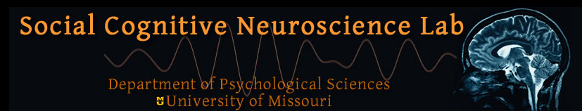
Thanks!
Social Cognitive Neuroscience Lab
Bruce Bartholow
Joe Hilgard
Kimmy Fleming
Meredith Johnson
Curt Von Gunten Funding:
Jorge Martins University of Missouri
Kira Bailey Life Sciences Fellowship
Scott Saults

